Slide 1
Sales Targets
Q2 2016
ACME
Corp.

Slide 2
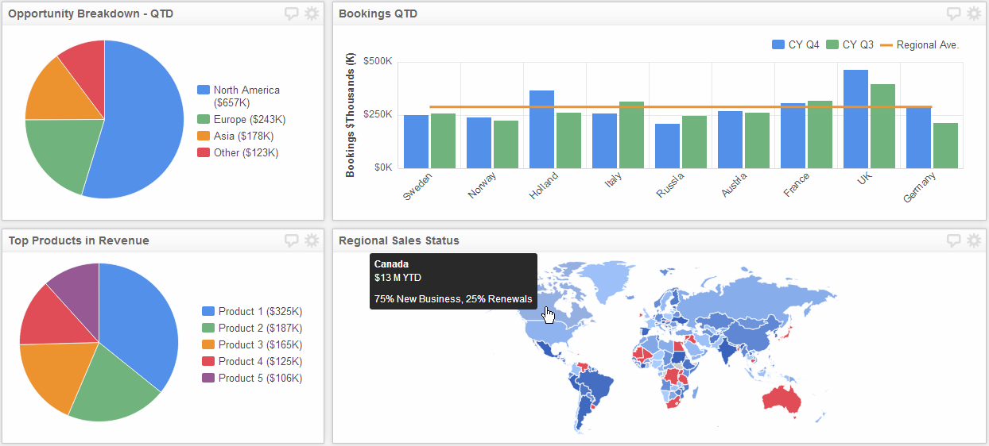
ACME
Corp.
Revenue Target

Slide 3
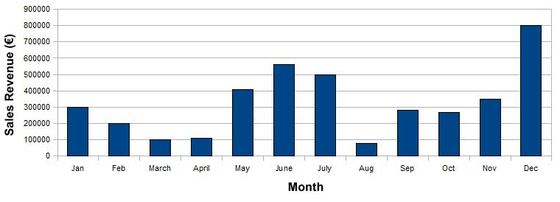
ACME
Corp.
Net New Customer
Targets

Slide 4
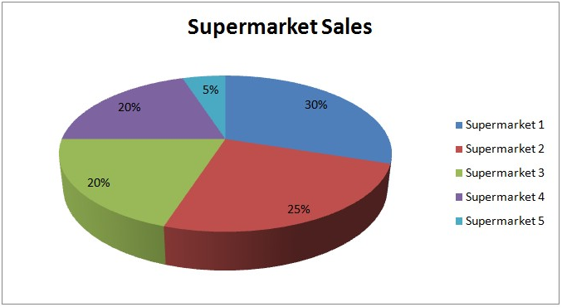
ACME
Corp.
Renewal
Targets

Slide 5
Good Luck in Q2!

